Slide 1

Unit 2 Voice and Accent
PEV 113

Slide 2
After this session
You would be able to know what are vowels and consonants
What are Syllables
You will be acquainted with basic concept of vowels and consonant sounds
You will be acquainted with basic concept of syllables and its usage in pronunciation

Slide 3
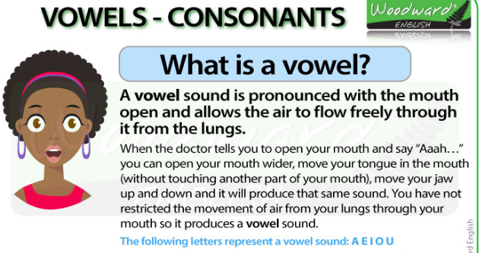

Slide 4
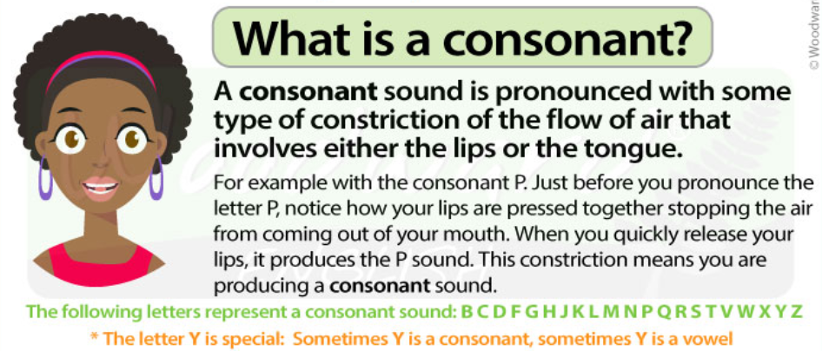

Slide 5

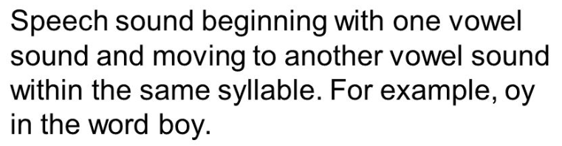
Vowel sounds are sounds that are produced by the un-interrupted flow of air

Slide 6
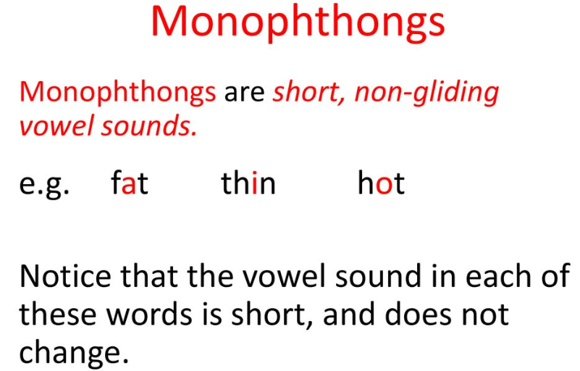

Slide 7
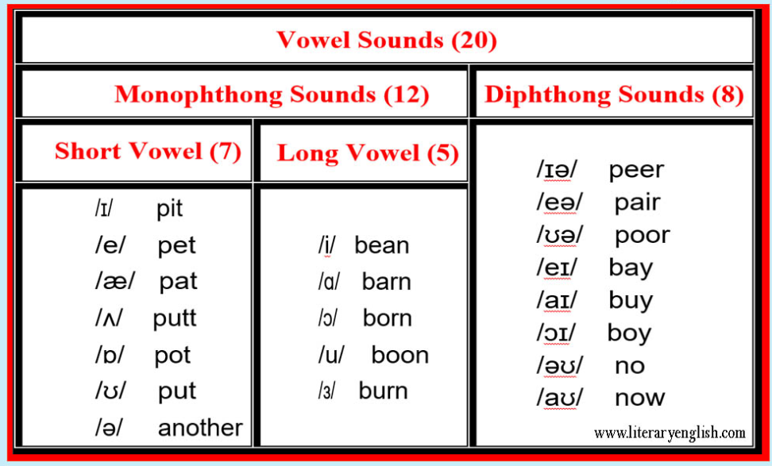

Slide 8

What are CONSONANTS?
Sounds produced by partial or full interruption of the breath flow.
Give clarity and sharpness to the words.
They do the work of making our speech crisp and clear, just like the function of treble in a music system.
When you whisper it is consonants that carry forward the sound and the meaning.

Slide 9
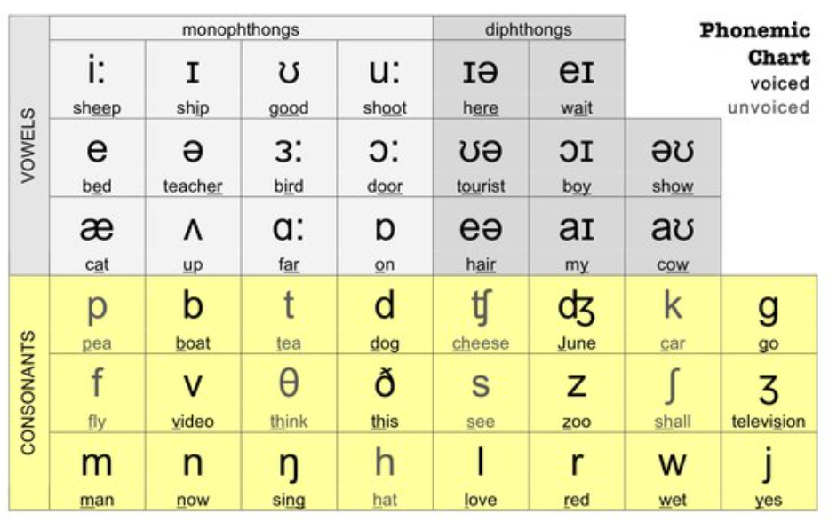

Slide 10
The English Consonant sounds are divided into two broad buckets, which are
● Voiced Consonants-Plosive
● Unvoiced Consonants- Non-Plosive
Consonant sounds can be produced either with or without a vibration of the vocal

Slide 11
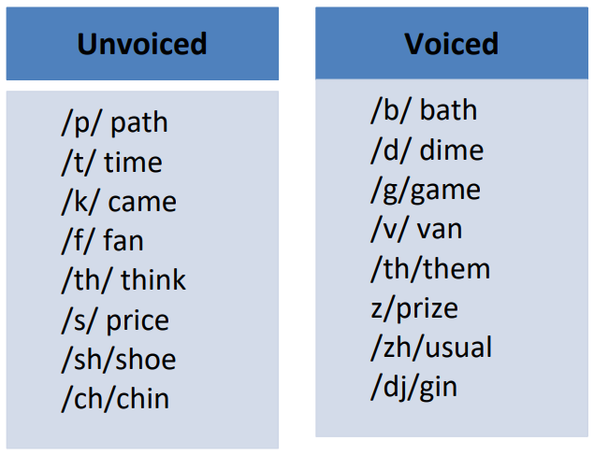

Slide 12
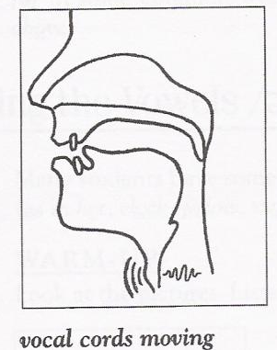
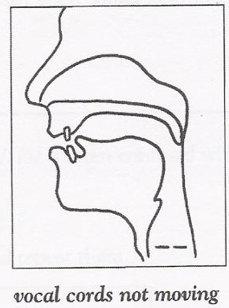

Slide 13
Syllables
Syllables are sound units that build up the structure of every word. They are a very important part of speech.
They give a word its pronunciation.

Slide 14
Syllables
Without them speech would sound dull, boring and meaningless.
Syllable is a unit of pronunciation having one vowel sound, with or without surrounding consonants, forming the whole or a part of a word; for example, there are two syllables in water and three in inferno.
Syllable Stress is very important to understand as using stress on the wrong syllable can affect our pronunciation.

Slide 15
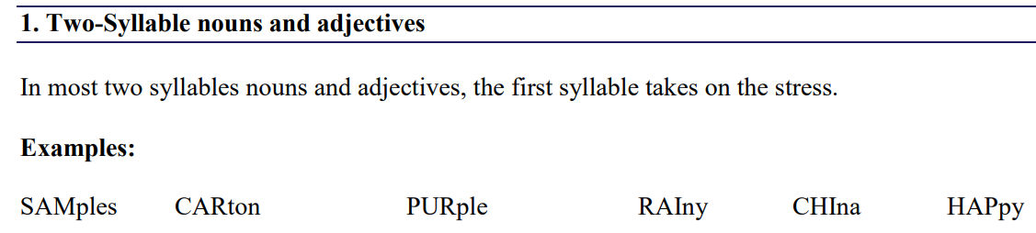

Slide 16
2. Two-Syllable verbs and prepositions
In most two syllables verbs and prepositions, the stress is on the second syllable.
Examples:
reLAX
diRECT
aMONG
aSIDE
betWEEN
deCIDE

Slide 17
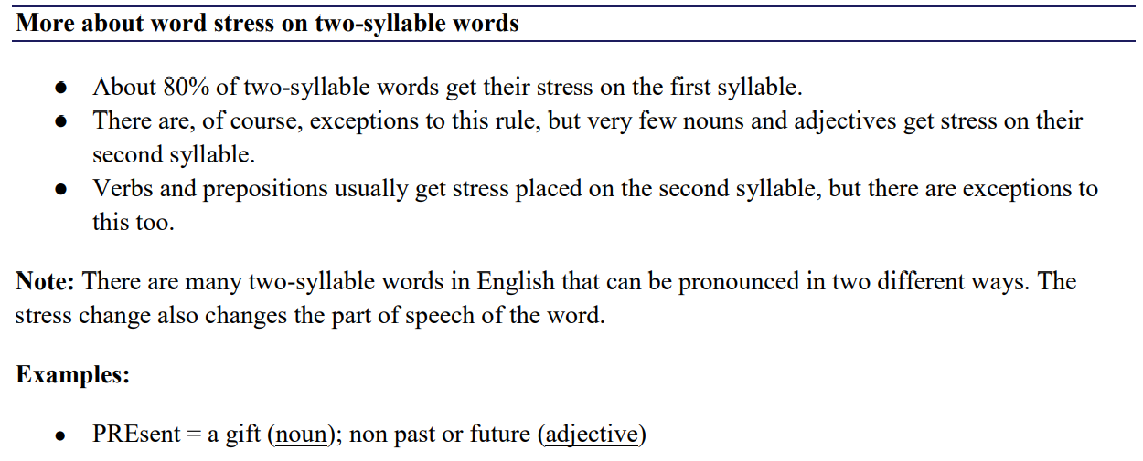

Slide 18
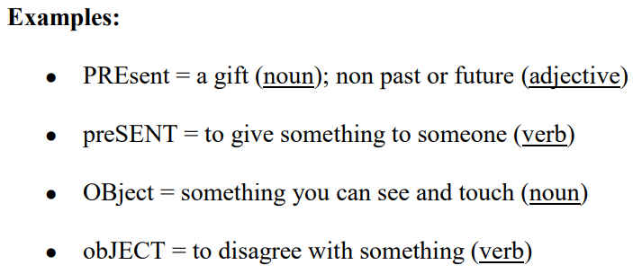

Slide 19

Three-Syllable words
For three-syllable words, word stress in on 2nd syllable most of the times. However, exceptions are always there.
adEquate amAzement attEntion attrActive banAna

Slide 20
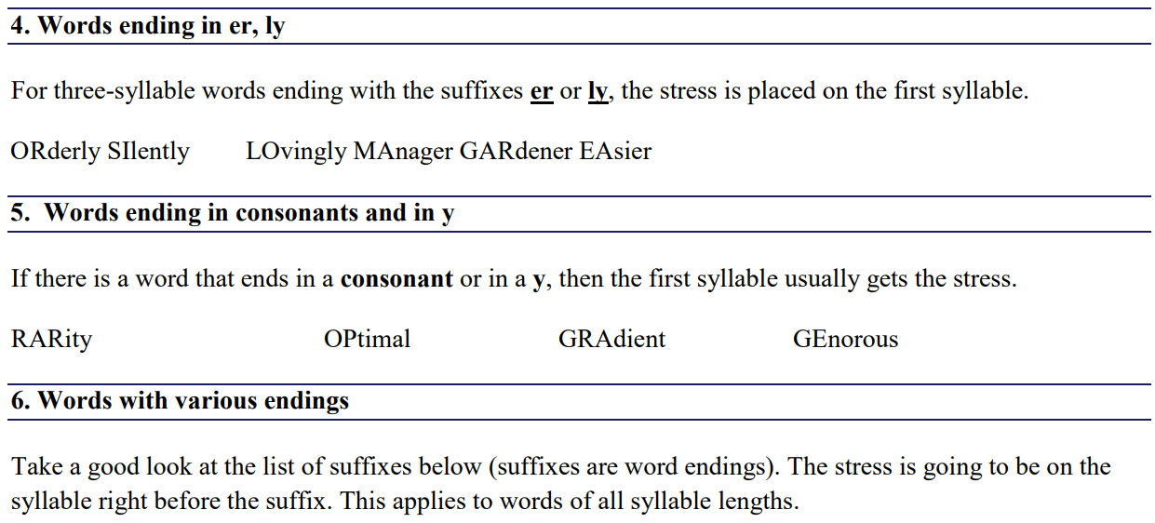

Slide 21
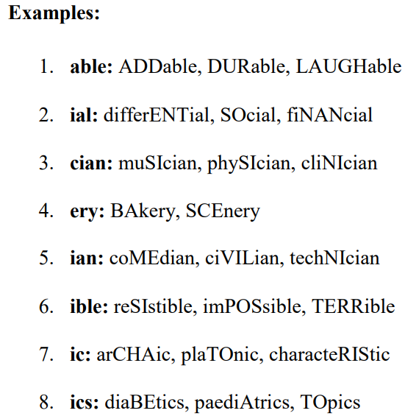
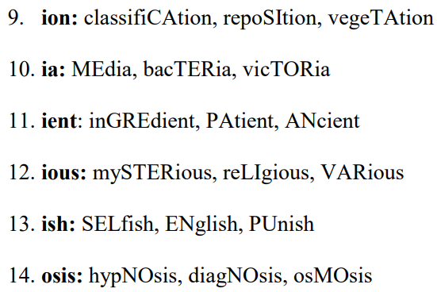

Slide 22
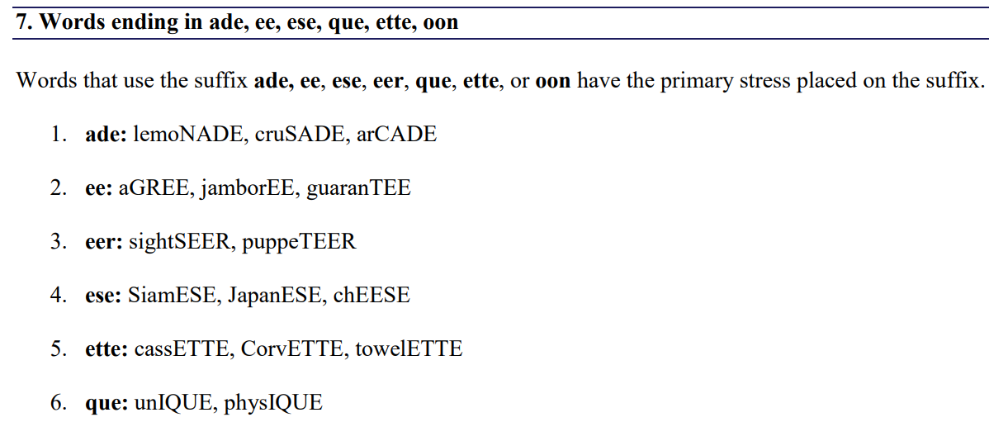


Slide 23
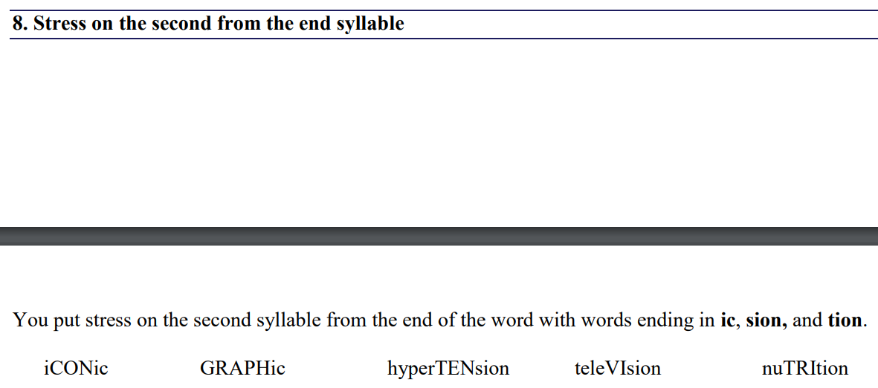

Slide 24
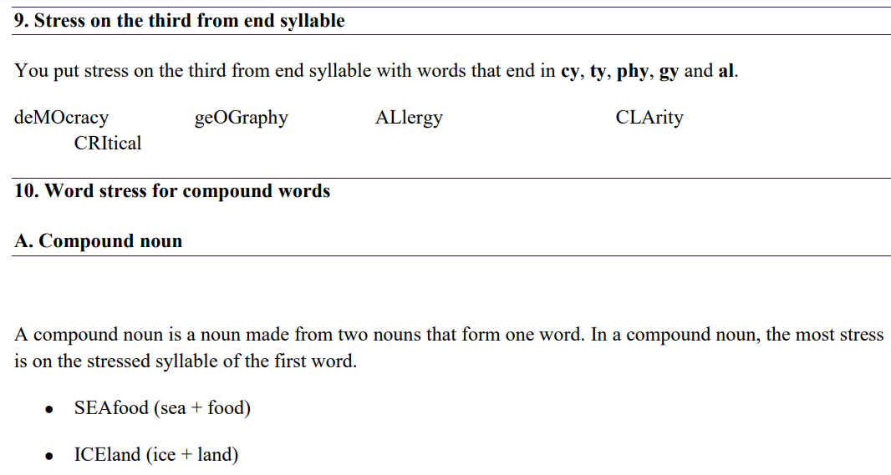

Slide 25
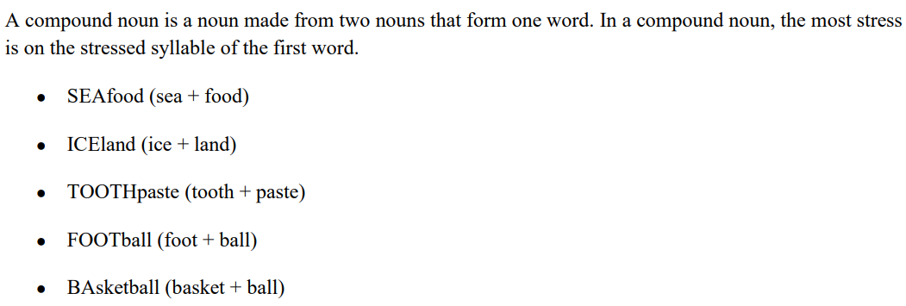

Slide 26
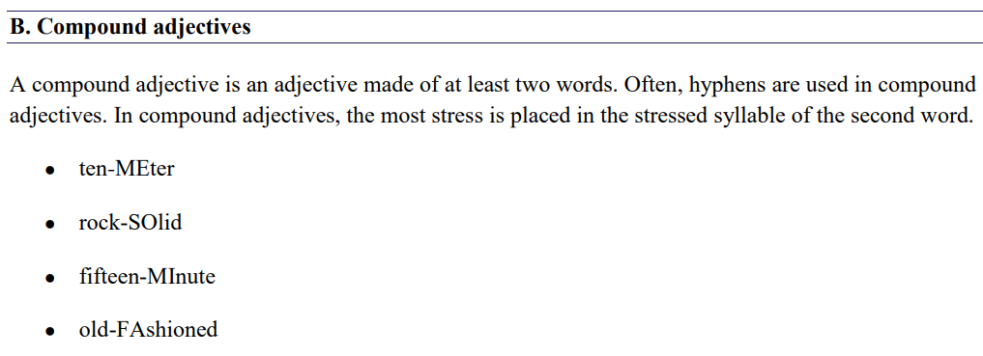

Slide 27
C. Compound verbs
A compound verb is when a subject has two or more verbs. The stress is on the second or on the last part.
Matilda loves bread but deTESTS butter.
Sarah baked cookies and ATE them up.
Dogs love to eat bones and love to DRINK water

Slide 28
D. Noun + compound nouns
Noun + compound Nouns are two-word compound nouns. In noun + compound noun, the stress is on the first word.
AIRplane mechanic
PROject manager
BOARD member

Slide 29
Reflexive pronouns
Reflexive pronouns show that the action affects the person who performs the action.
For example:
I hit mySELF.
The second syllable usually takes the stress.
● mySELF ● themSELVES ● ourSELVES

Slide 30
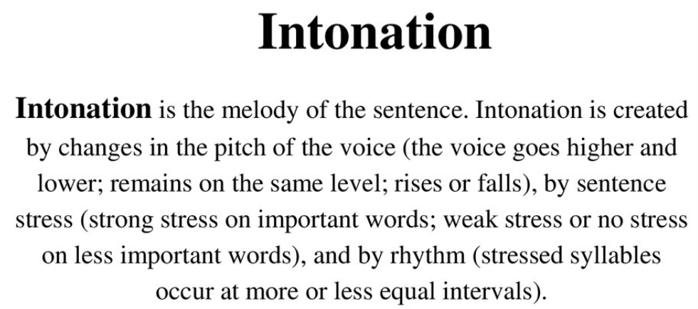

Slide 31
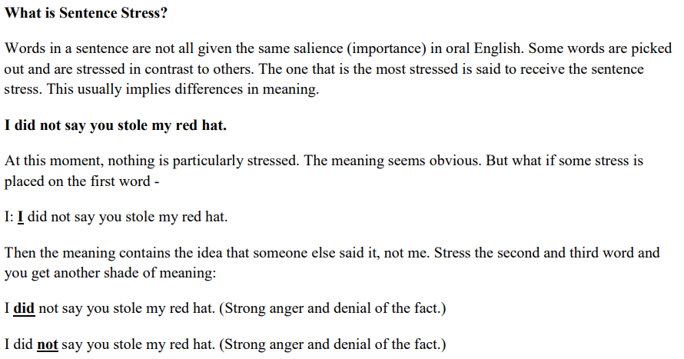

Slide 32
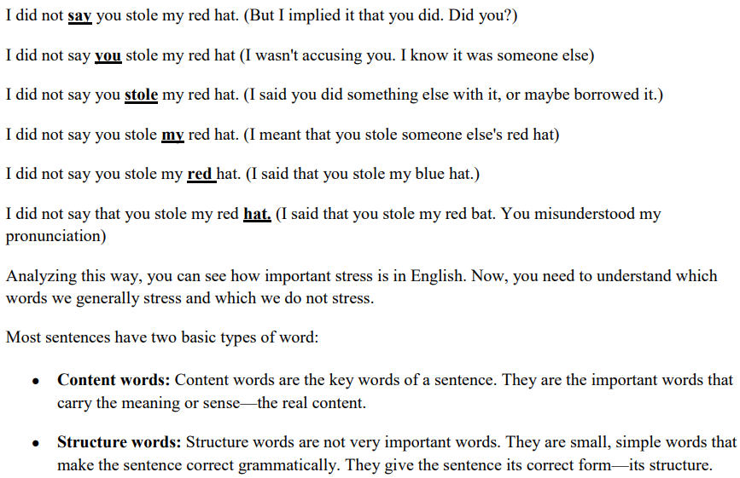

Slide 33
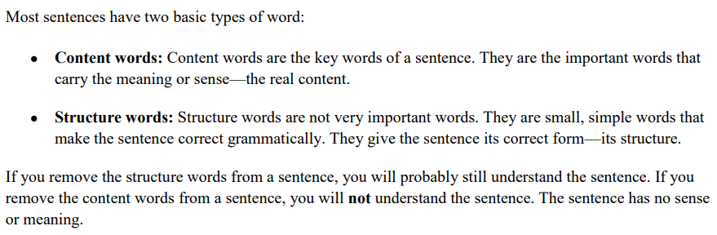

Slide 34
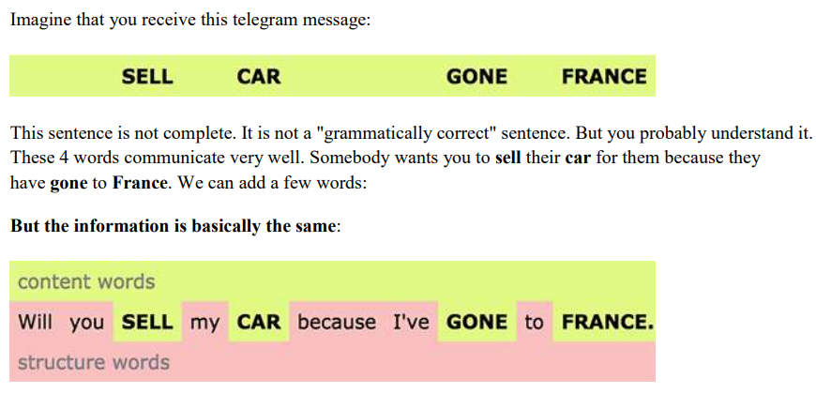

Slide 35
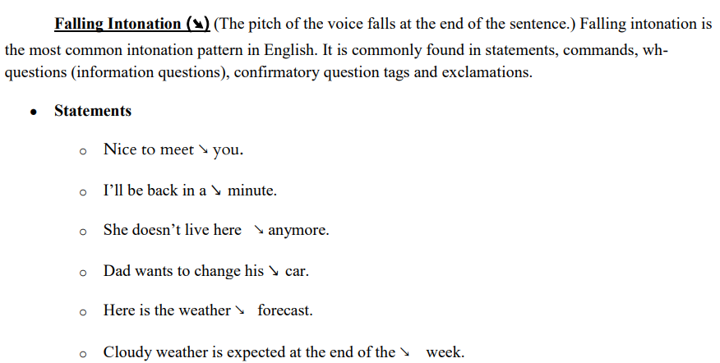

Slide 36
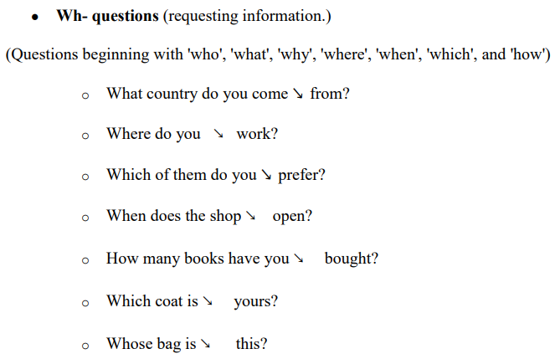

Slide 37
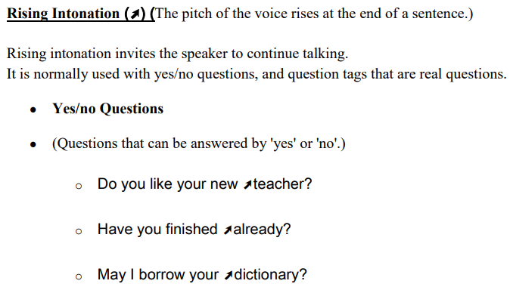

Slide 38
